Slide 1
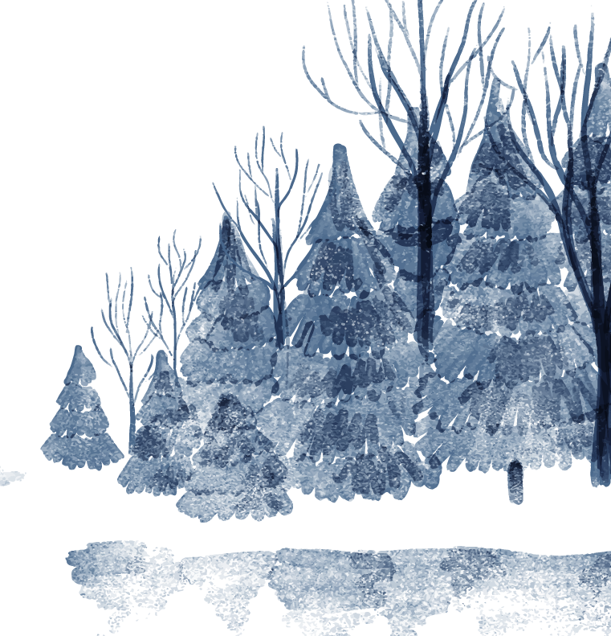

Winter
Cabin
Alexandre Teixeira | André Sebastião | Daniela Peixoto | Rodrigo Pires | Vitor Daniel

Slide 2



Specs
Platform
Genre
Players
Perspective
Windows PC
Puzzle Solving
Escape Room
Singleplayer
3D First Person

Slide 3
Pitch
Stuck in a log cabin in the middle of a snow storm, it's up to you to coordinate with your team and escape together.

Slide 4
Unique Selling Points
Out of the box Puzzles
Coordinate with your team
These puzzles are meant to test your interpretation skills.
You will receive information from your team and it’s up to you to figure out how that information will help you.
You are stuck in a log cabin, far away from the rest of your team.
The upside is that you can help them with the information you have around you

Slide 5
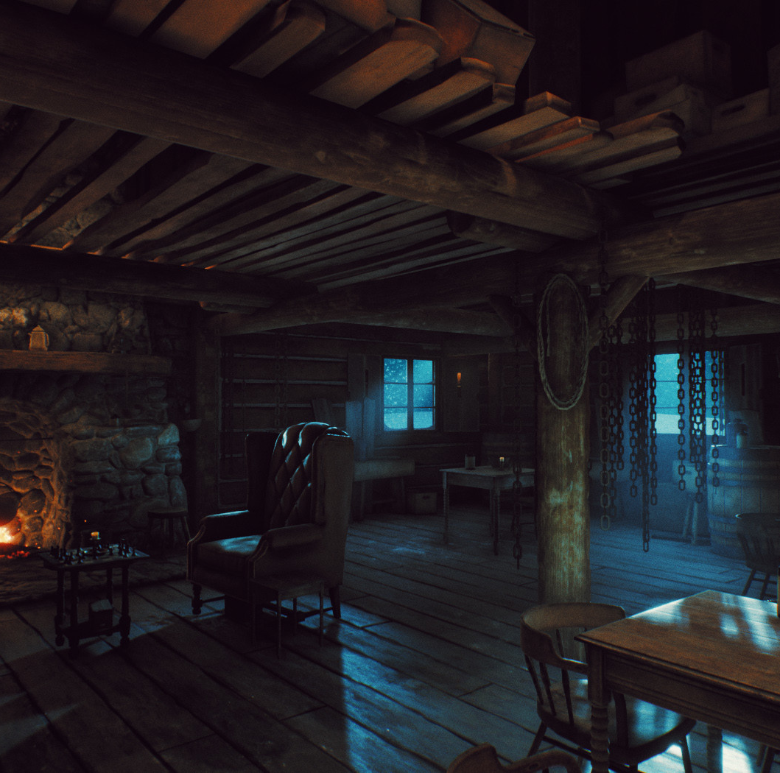
History and
Theme
You are the Head of Operations in your exploration team consisting of moles and as such you are responsible to organize the team and help them delve into ruins from the safety of the control post.
Unfortunately, during one of those missions you and your team got stuck in a snowstorm.
Without any means of being rescue it’s up to you to help your team and t’s not going to be easy, moles are not know to maintain calm during stressful events…

Slide 6



Game Loop
Explore the Hut!
A New Discovery!
Can I solve it?
I Got It!
Throughout the hut there is information that may help you
Your team of moles will give you information
Retrieve the important stuff and reach a conclusion
Deliver the solution to the other moles

Slide 7
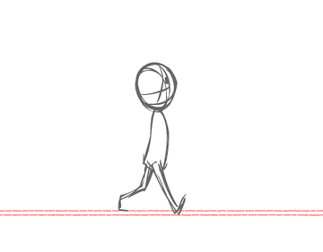
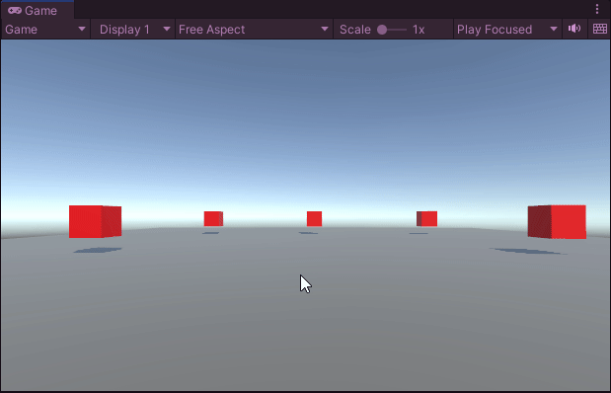
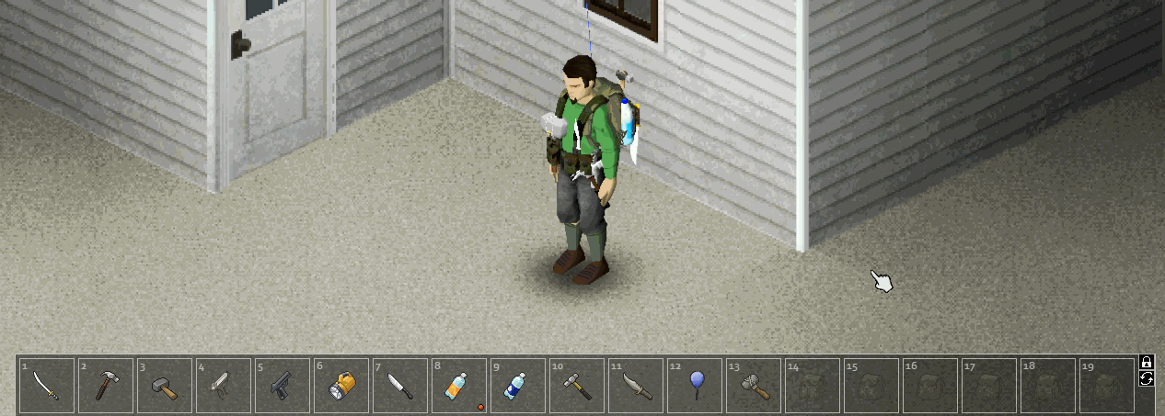
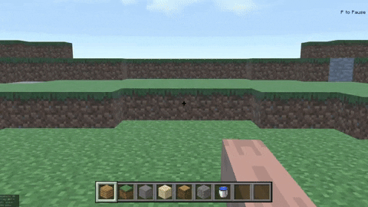
Mechanics
Movement
Camera
Interactions

Slide 8
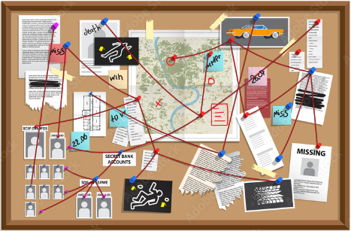
Mechanics
Board
Highlight Information
Key Discoveries!
Organization!
Highlighted information will be transmitted to the other moles when talking on the radio.
Key pieces of information the player discovers gets saved on the board
You are free to organize how the information on the board is presented

Slide 9
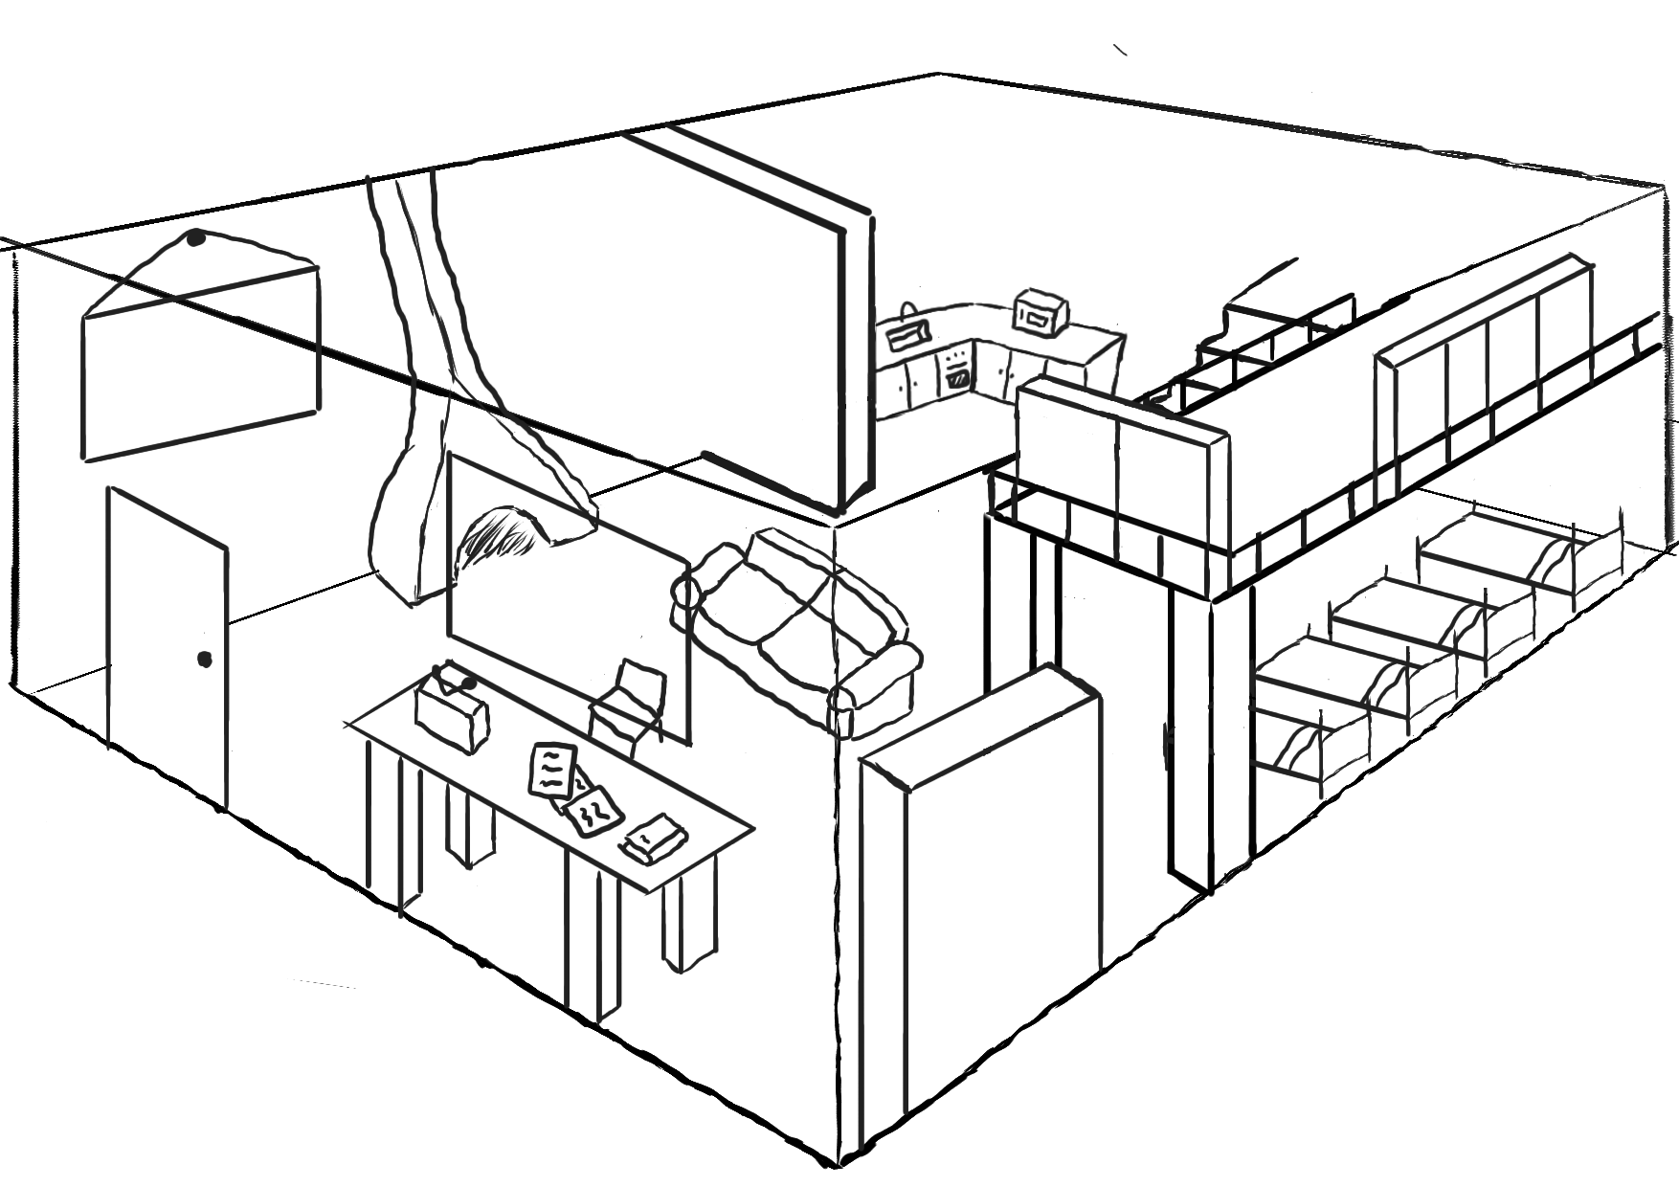
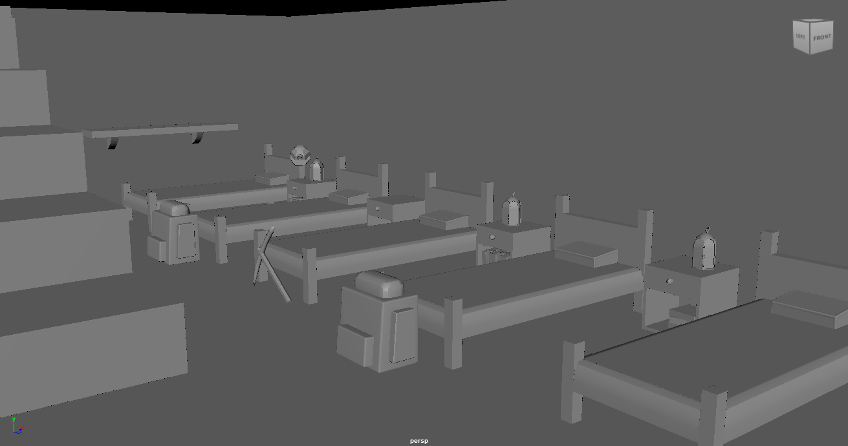
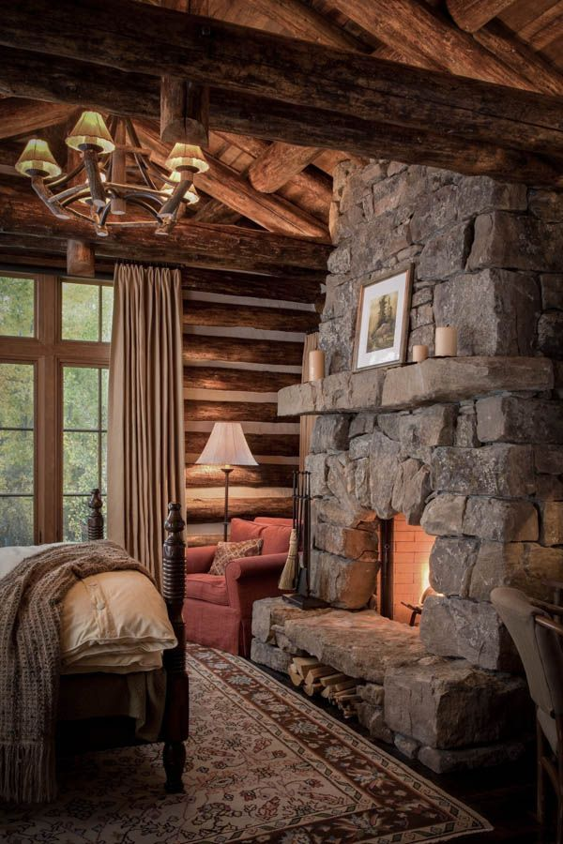
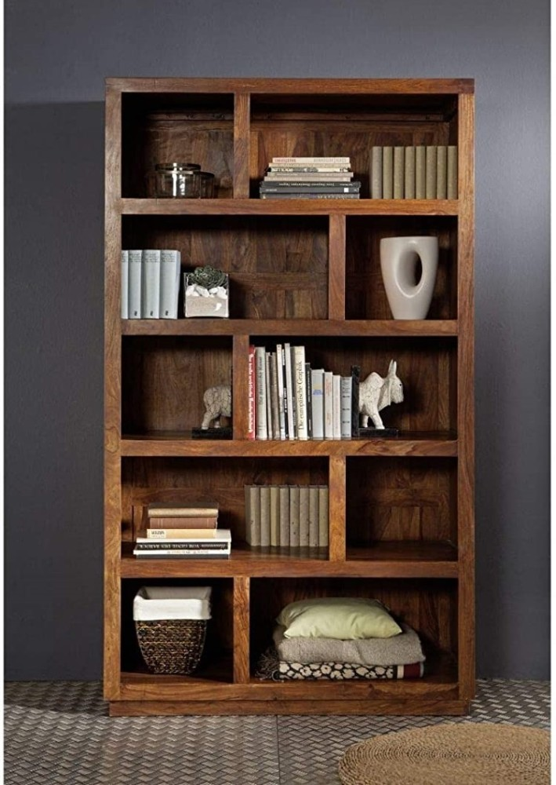
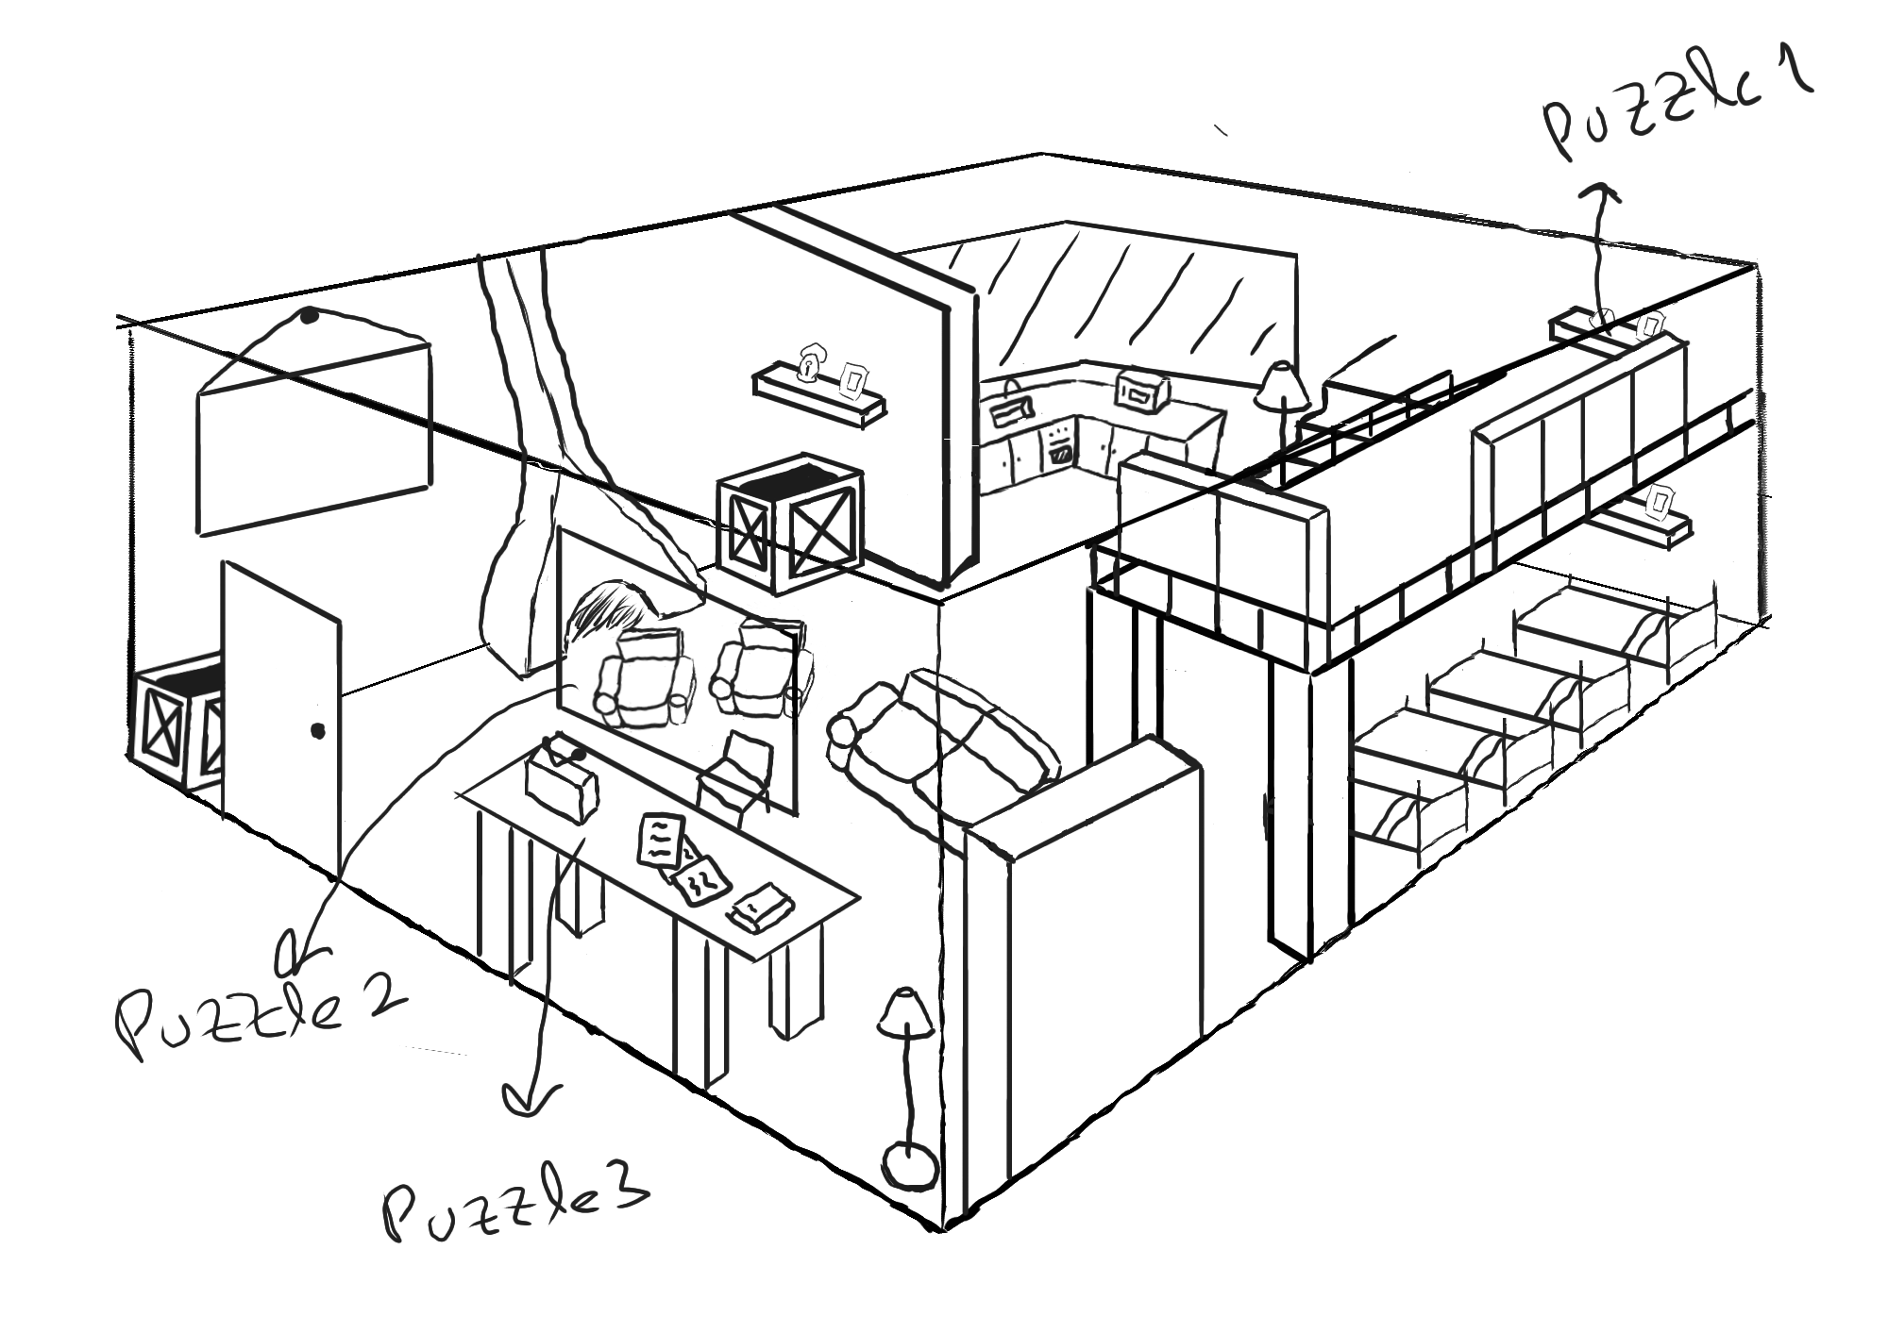
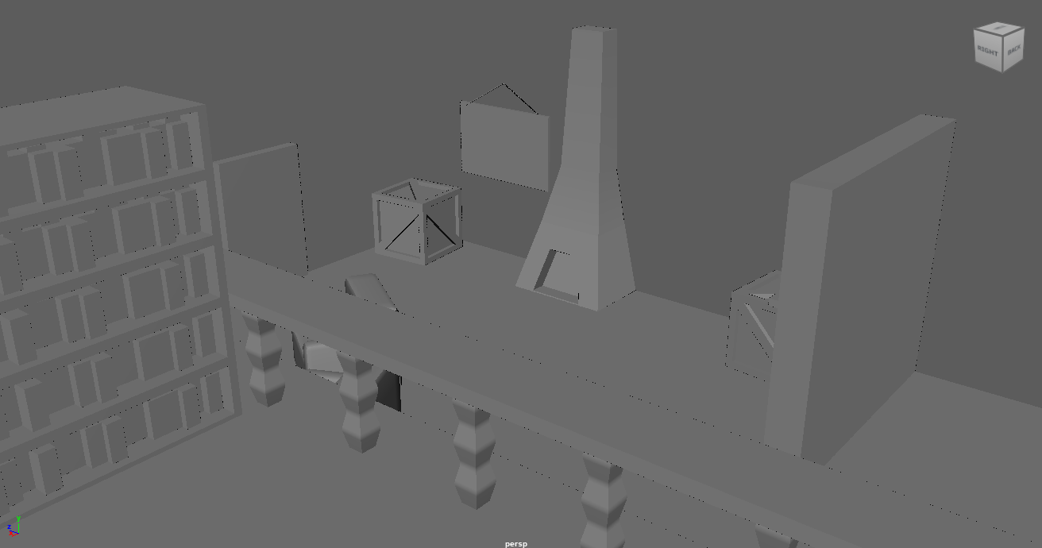
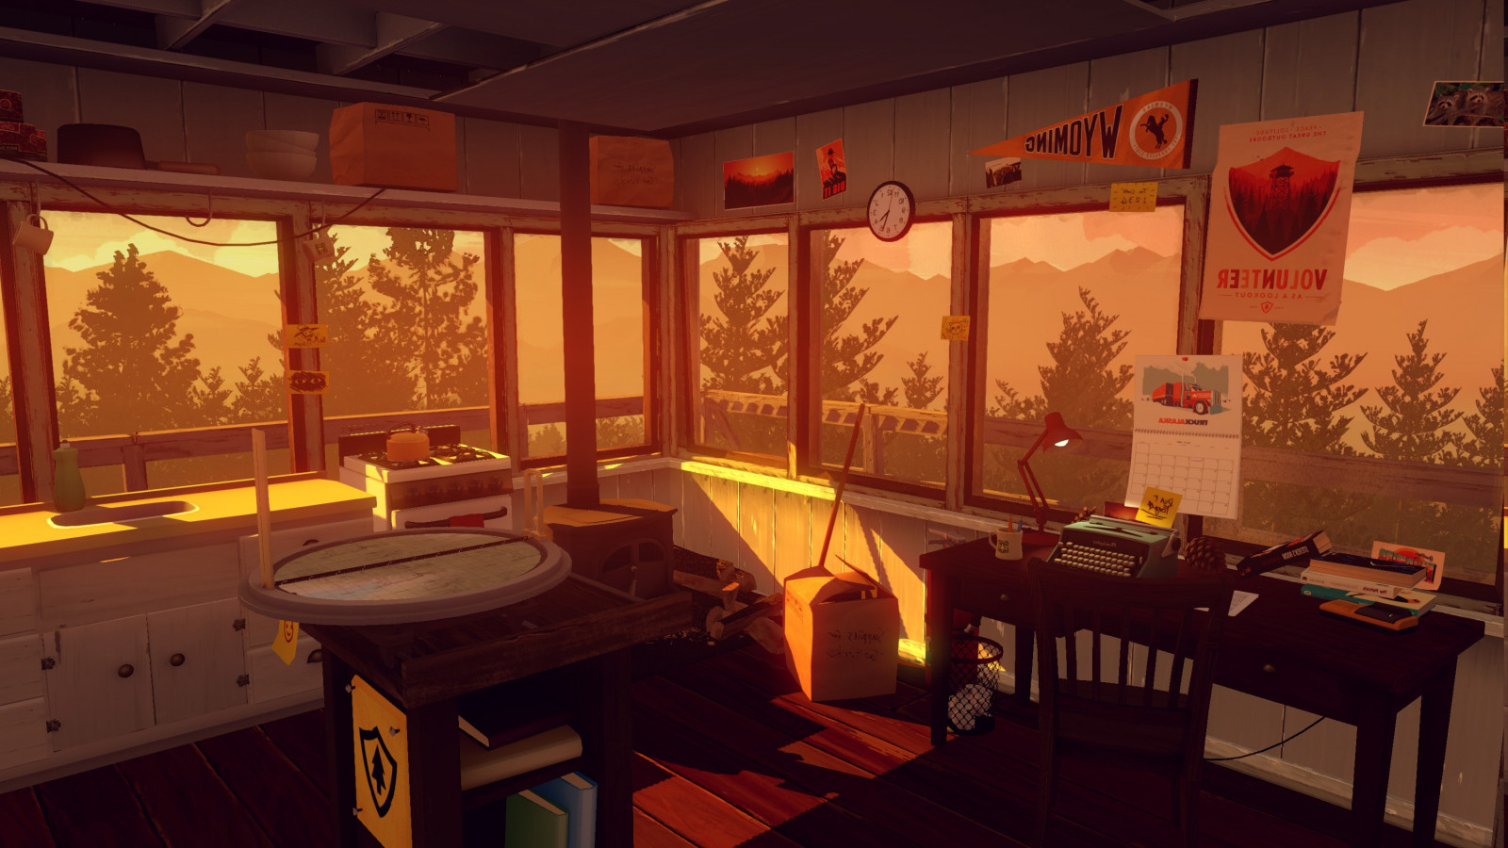
Visuals
Layout
Medium Poly
Vintage / Rustic

Slide 10
Music / Sound
Ambient Sounds
Interactive Sounds
Voice Acting
Background Music
Strong Winds
Heavy Snow Falling
Folly of books,footsteps on the wood floor, radio noises
Animal Crossing style voices for the characters
Lo-fi
Soft and Chill music

Slide 11
Thank
You

